Slide 1


Surviving Life as a Researcher
Jacob Beal
FAS* Doctoral Symposium
Augsburg, Germany
September, 2016

Slide 2
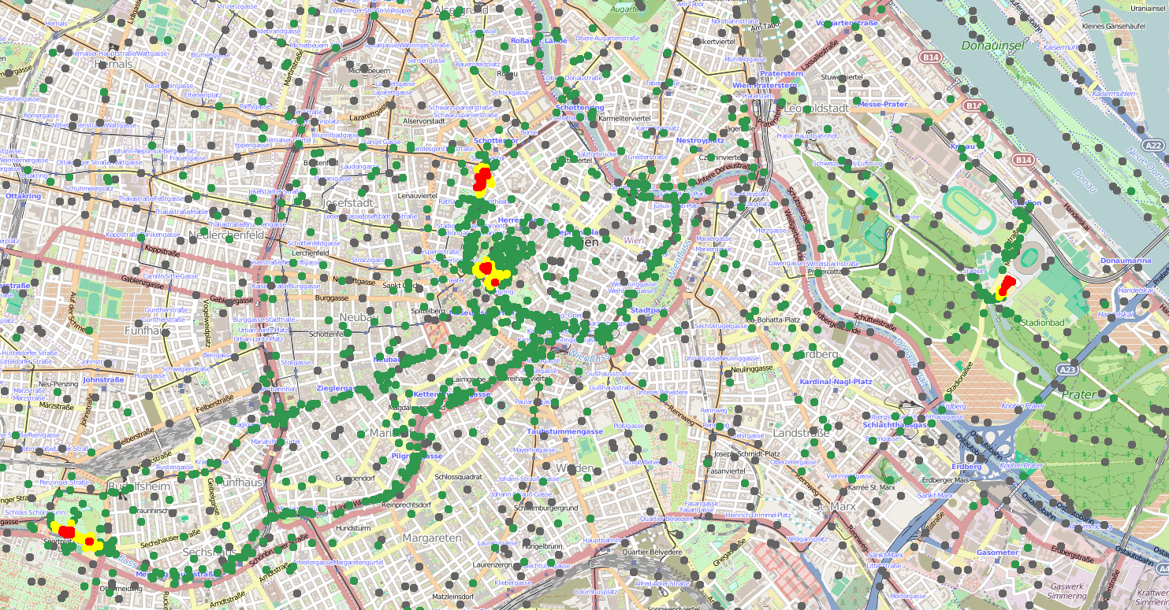
Who am I, and what do I do?
Aggregate Programming
Synthetic Biology Analytics & Design
Field Calculus, Spatial Computing
Calibrated Flow Cytometry
Spatial Patterning
Resilient Networking
Precision Organism Engineering
High-Performance Devices
U6
gRNA-a
pConst
cas9m-BFP
CRa-U6
EYFP
Beal et al., Computer, 2015,
Beal & Bachrach, IEEE Int.Sys. 2006,
Beal & Bachrach, SCW, 2008
Kiani et al., Nat. Meth., 2014,
Beal et al., ACS Syn.Bio., 2012,
Beal et al., ACS Syn.Bio., 2014

Slide 3
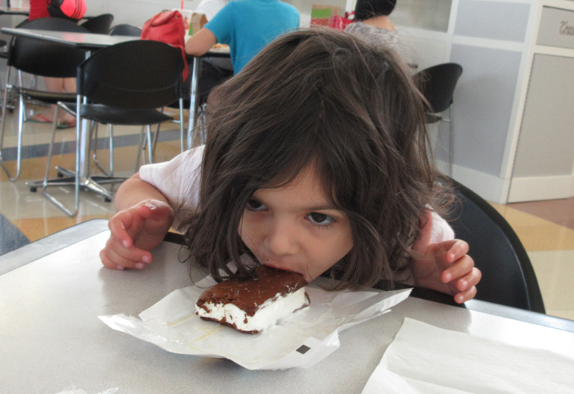
Why are we here today?
If I were a sensible man, I’d be home with my family
Researchers, artists, entrepreneurs → driven people
What knowledge can help us survive and thrive?

Slide 4
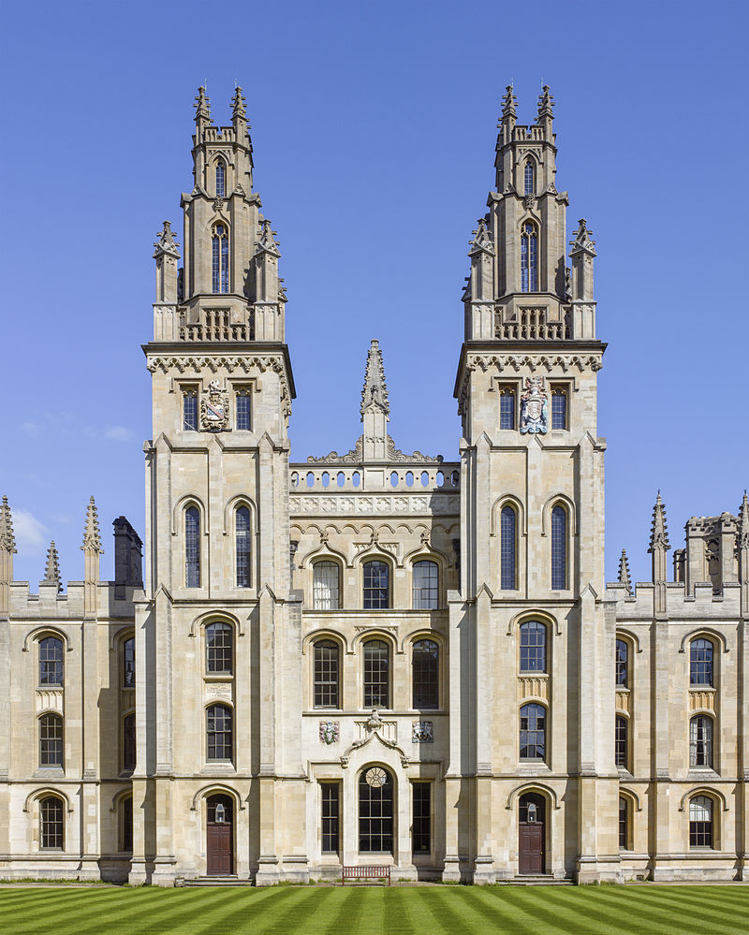
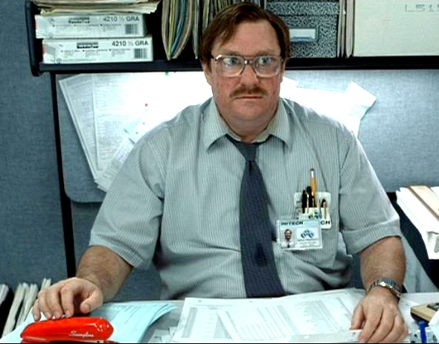

The research ecosystem is complex
Industry
Science!
The view from graduate school

Slide 5
The research ecosystem is complex
Foundations
Educational
Non-Profits
Startups
Government
Laboratories
Corporate
Labs
Universities
Funding
Organizations
Research
Companies
Consulting
Places you don’t want to work
Non-University
Institutes
Professional
Societies
Publishers
Pre-Competitive
Industrial Organization
Specialty
Centers
Reality is much more complicated

Slide 6
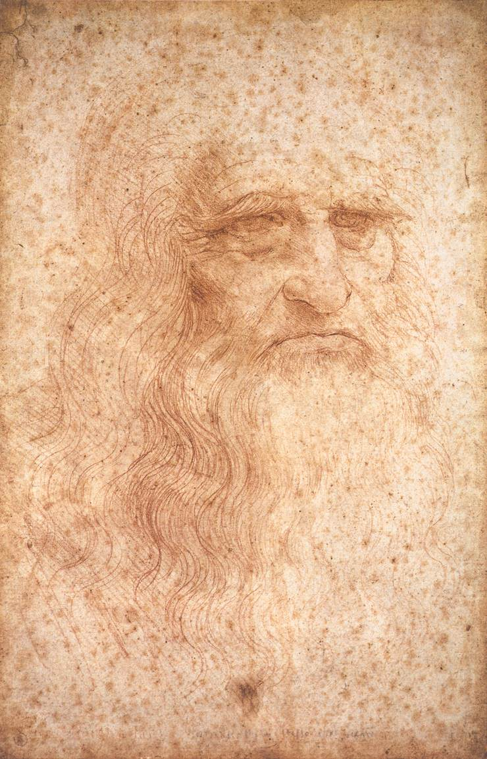
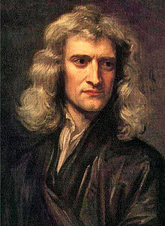
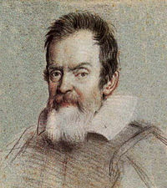
The Renaissance Man is Dead
Scientific mythology and ideals are still largely grounded in the era of “gentlemen scientists”
Our world is much faster, more complex, interconnected
Notes:
da Vinci, Galileo, Newton

Slide 7
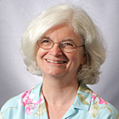
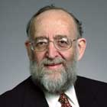
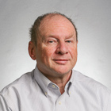
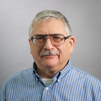
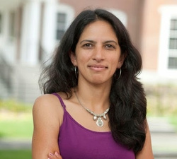
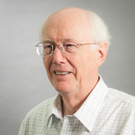
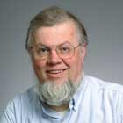
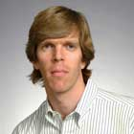
There are many niches for researchers
Mathematician
Scholar
Educator
Administrator
Hacker
Integrator
Visionary
Iconoclast
Notes:
Nancy Lynch, Howie Shrobe, Joel Moses, Hal Abelson, Radhika Nagpal, Tom Knight, Martin Rinard, Dave Clark
Three of them aren’t even professors

Slide 8
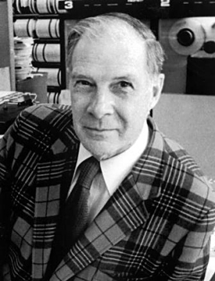
Hamming: “You and Your Research”
Why do some do great work, while others just as smart fail to?
Think great thoughts
Work hard on important problems
Look for generalization
Work with your door open
It’s OK to appear to conform
Learn to communicate
http://www.cs.virginia.edu/~robins/YouAndYourResearch.html

Slide 9
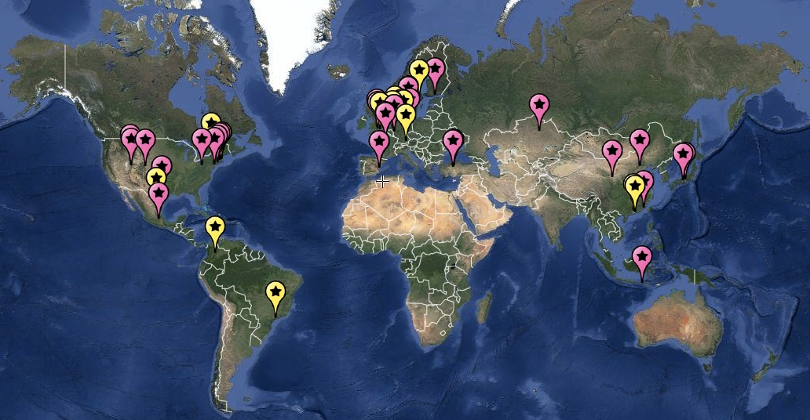
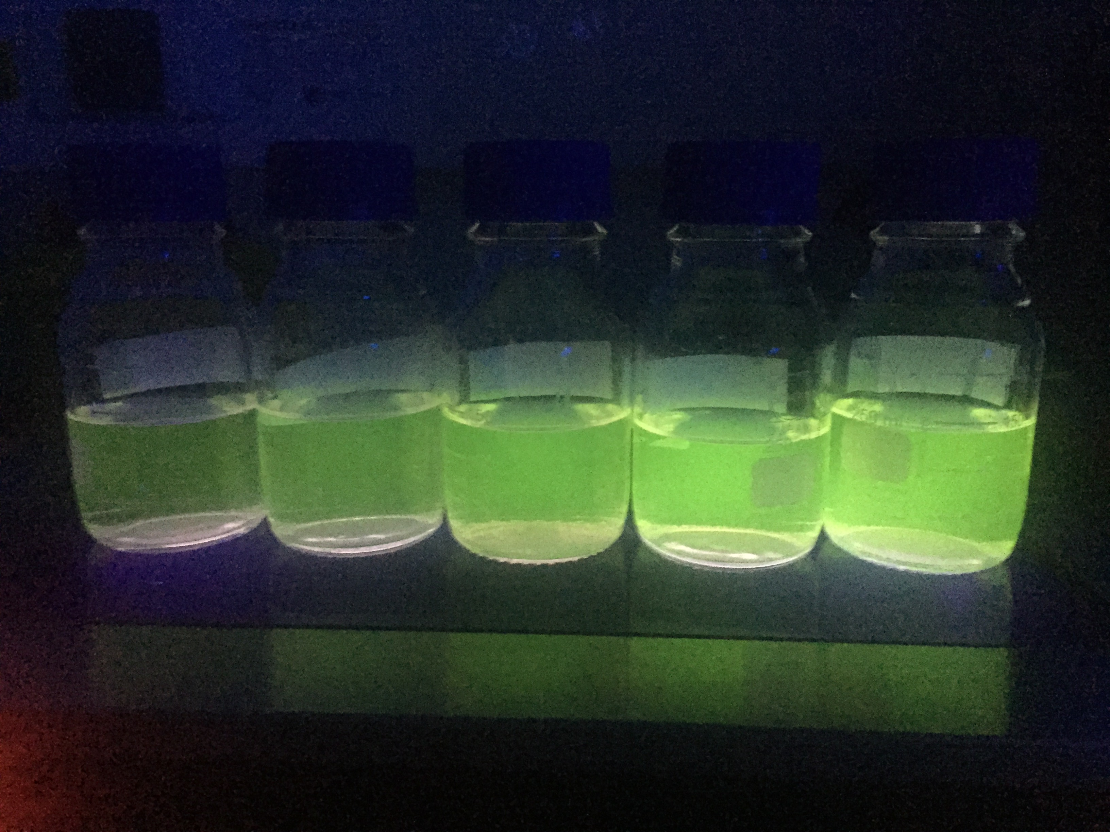
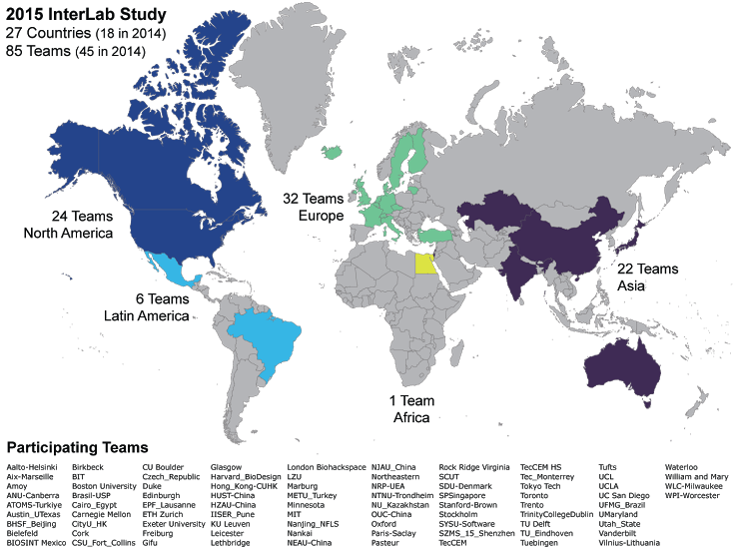
My most important recent project
iGEM interlab study: organized 130 teams around the world to study a fundamental measurement problem in synthetic biology
2014 Teams
2015 Teams
Image from iGEM Oxford 2015
Massive community effort
Critical results on a pressing problem
Nobody funded it.
Rejected by high impact → published in PLOS ONE
Still making a big impact (we think)

Slide 10
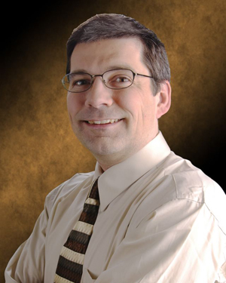
Your focus is likely to shift over time
“No matter what, we’ll never be doing the same work 10 years from now. Either we will have succeeded and moved on, or else we will have failed and need to go try something different.”
– Joe Loyall
My own history of technical ambition:
1995: Video game programming
2002: Human-level AI
2009: Spatial computing
2016: Synthetic biology, aggregate programming

Slide 11
A Three-Way Pivot
Vision
Skills
Application
At different times, different aspects dominate

Slide 12

Bruno Latour: Anthropology of Science

Slide 13
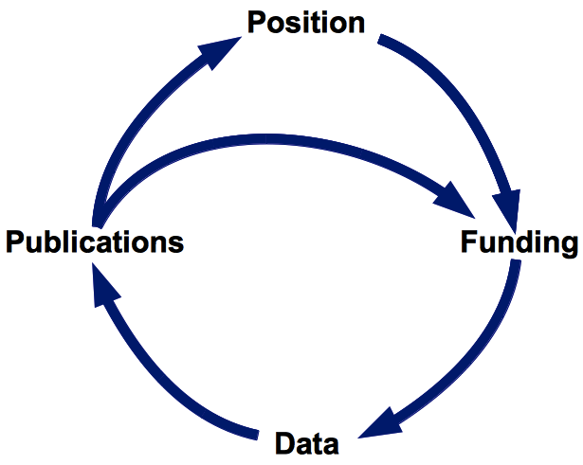
Latour’s Cycle of Credit
Ensuring your work
is visible to others
Planning work that
may be important
Explaining your
work’s significance
Doing good work
What grad school
usually focuses on

Slide 14
Latour’s Cycle of Credit
Planning work that
may be important
Explaining your
work’s significance

Slide 15
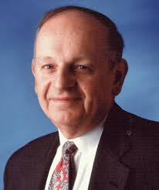
Heilmeier's Catechism
1. What is the problem, why is it hard?
2. How is it solved today?
3. What is the new technical idea;
why can we succeed now?
4. What is the impact if successful?
5. How will the program be organized?
6. How will intermediate results be generated?
7. How will you measure progress?
8. What will it cost?

Slide 16
Latour’s Cycle of Credit
Ensuring your work
is visible to others

Slide 17
Being visible in the community
Organize events
Review papers
Give talks
Help teach
Serve on panels
Write a blog
Maintain your webpage
I budget 4 hours / week for service & visibility

Slide 18
Latour’s Cycle of Credit
Survival as a
human being

Slide 19
Imposter Syndrome
Before nearly every conference I go to, before nearly every talk I give, I have a horrible moment of doubt, wondering why I am here.
Remember:
Everybody shows the face they want the world to see.
Selection bias greatly distorts your view of the world.
You and your work’s value is not relative.
Become comfortable working with areas of ignorance.
Even just knowing about it can help a lot.

Slide 20
Find support for yourself
One of my favorite resources

Slide 21
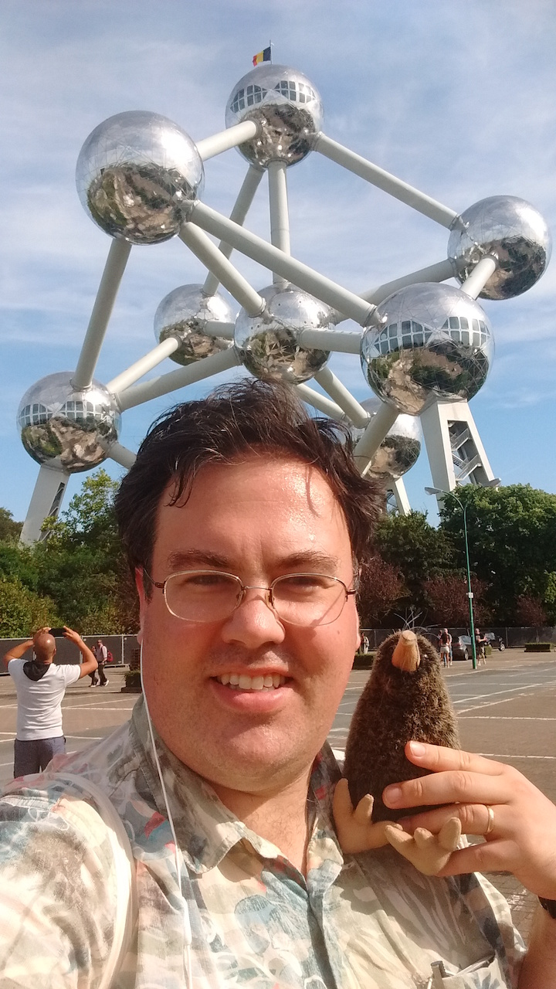
Keep an eye on your life
It’s never a good time for life.
Do it anyway.
Compromise, triage.
Drop different balls.
Keep track of your time:
Make time for focused work.
Do scut work in broken time.
Walk away from burnout.

